Slide 1

GLOBAL PHYSICAL GAME SALES
How do sales compare across North America, Europe, Japan, and other regions?

Slide 2
WHY ARE WE LOOKING AT THIS?
As a gaming company with global reach, we need a deep understanding of how the video game market is changing across the globe.
We have been allocating our marketing budget based on the assumption that sales and growth are remaining about the same over time. By testing this assumption, we can see if we are doing the right thing, or whether we need to rethink our marketing strategy.
Is the video game market growing or contracting at the same rate in North America, Europe, Japan, and other regions?
What about the popularity of various genres of games?
WHAT DOES THE DATA REALLY SHOW?

Slide 3
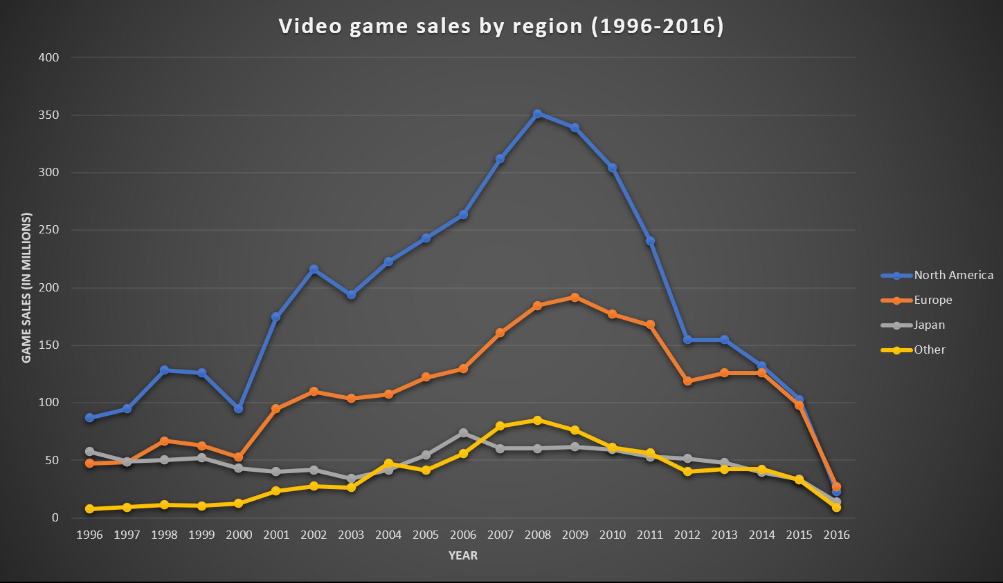
Total sales
Key takeaway: Physical game sales have fallen drastically since 2008, especially in North America
Are game sales collapsing?
Not necessarily. This data only shows physical sales. We need data on digital sales to get a more complete picture.
What happened in 2016?
2016 data is very likely incomplete, since sales from the previous year appeared to decline by 370%. So, this data may not tell the whole story.

Slide 4
Sales by region
Key takeaway: Europe has been gaining ground as a share of global sales, while NA continues to decline.
Other regions are growing
Regions outside North America, Europe, and Japan are steadily gaining ground as a share of total sales. More research should be done on these emerging markets.
What happened in 2016?
Europe finally overtook NA. Japan sales spiked while NA sales slumped. Remember that this data may be incomplete, so take it with a grain of salt.

Slide 5
Genre popularity
Key takeaway: Japan dominates puzzle games, while Europe loves racing games. NA is more diverse.
Data is from last 2 years only

Slide 6
Genres over time
Key takeaway: RPGs are consistent in Japan. Shooters have gained in NA, Europe. Puzzle, racing have waned.

Slide 7
WHAT THIS ALL MEANS
This data shows us that physical sales of games are declining in a big way. Digital sales are likely causing this.
As this is happening, Europe and “Other” regions have been enjoying steady growth proportional to NA and Japan.
Genre data from the last several years shows us that different regions have different genre preferences, and those have changed over time.

Slide 8
RECOMMENDED ACTIONS
GameCo should work on procuring data on digital sales to get a more complete picture of gaming market trends.
GameCo should allocate more marketing resources to Europe and “Other” region markets since these sectors are showing consistent growth and will likely continue to grow.
GameCo should find an answer to why the North America market (biggest market until 2016) is declining so rapidly.
GameCo should focus on marketing games genres that have been consistently popular or are trending upward in their respective regions.

Slide 9
THANK YOU!
We hope these data insights will help inform a smart marketing strategy.

